Slide 2
http://www.youtube.com/watch?v=pcVZM2i2HZQ&feature=related

Slide 3
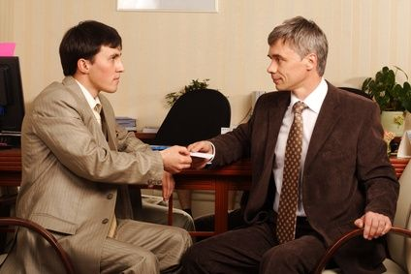
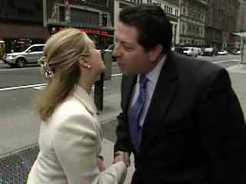
Greetings around the world

